Slide 1
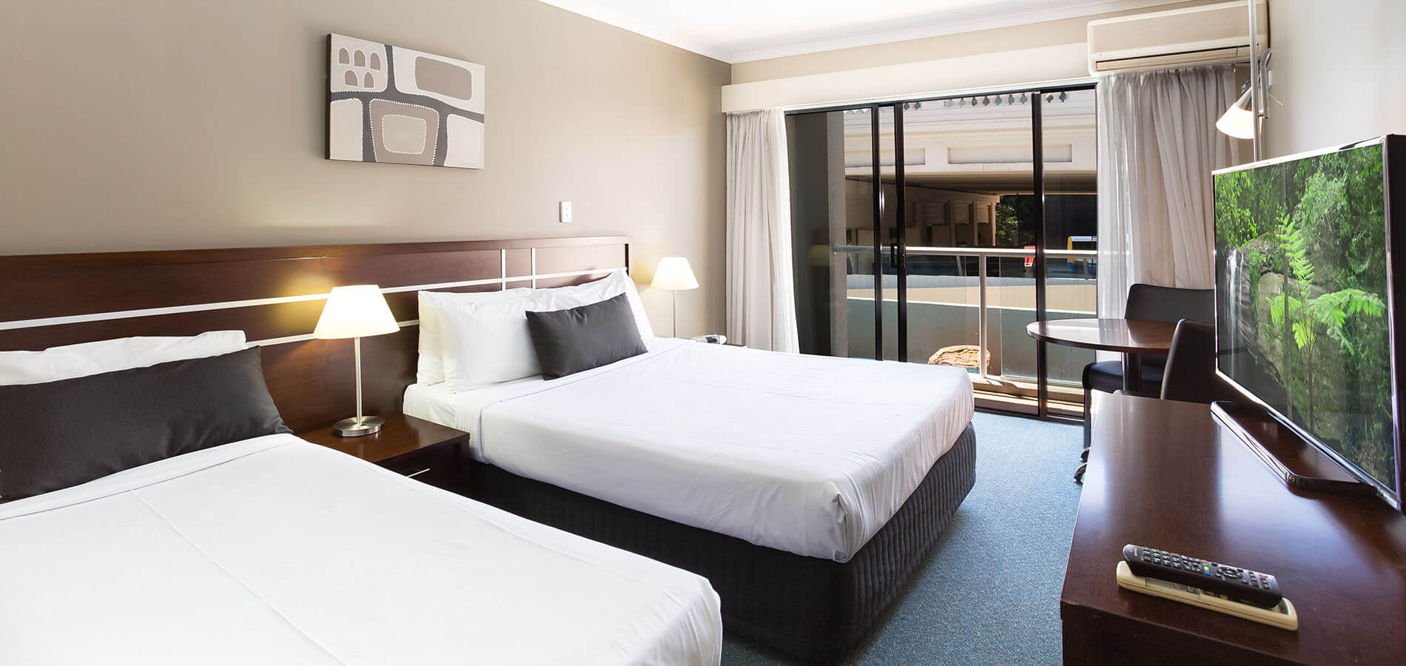
Riverside Hotel 80814林淑媛
2. larger room, clean and clear
1. low price of room, convenient
3. museums, art galleries, and a state library around.

